Slide 1

Unit-6: Exploring Graphs
Analysis and Design of Algorithms (ADA)
GTU # 3150703
Dr. Gopi Sanghani
Computer Engineering Department
gopi.sanghani@darshan.ac.in
9825621471

Slide 2

Outline
An introduction using Graphs
Undirected Graph
Directed Graph
Traversing Graphs
Depth First Search (DFS)
Breath First Search (BFS)
Topological sort
Connected components
Articulation point
Looping

Slide 3
Introduction to Graph

Slide 4
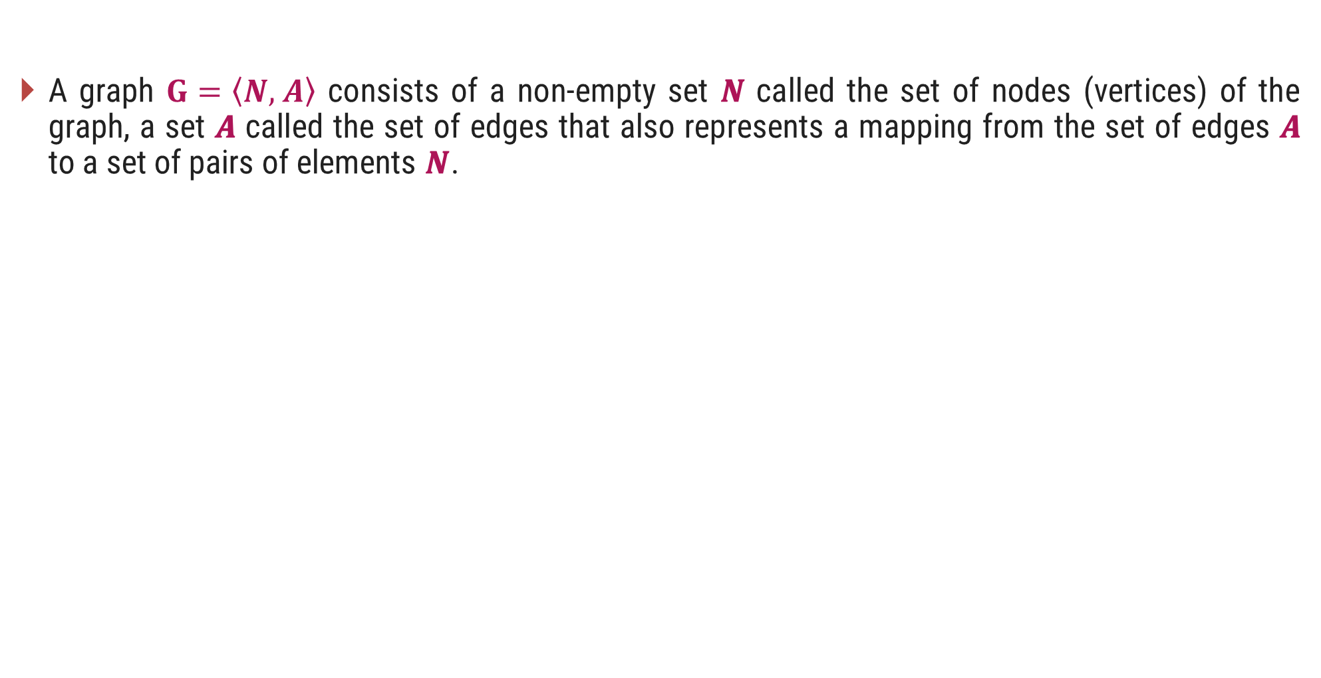
Graph - Definition
A graph $G=\left\langle N, \right.\left.A\right\rangle$ consists of a non-empty set 𝑵 called the set of nodes (vertices) of the graph, a set 𝑨 called the set of edges that also represents a mapping from the set of edges 𝑨 to a set of pairs of elements 𝑵.
edges
(or links)
D
A
E
C
B
F
nodes
(or vertices)

Slide 5
Directed & Undirected Graph
Directed Graph: A graph in which every edge is directed from one node to another is called a directed graph or digraph.
Undirected Graph: A graph in which every edge is undirected and no direction is associated with them is called an undirected graph.
Directed Graph
Undirected Graph

Slide 6
Traversing Graphs

Slide 7
Traversing Graph/Tree
Preorder
Visit the root.
Traverse the left sub tree in preorder.
Traverse the right sub tree in preorder.
In order
Traverse the left sub tree in in order.
Visit the root.
Traverse the right sub tree in in order.
Post order
Traverse the left sub tree in post order.
Traverse the right sub tree in post order.
Visit the root.

Slide 8
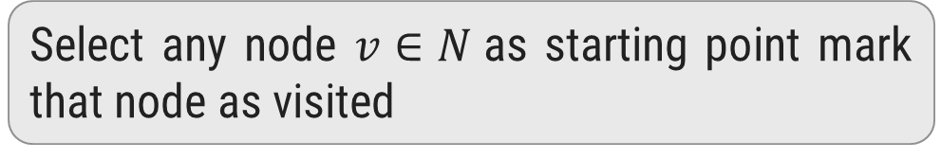
Depth-First Search / Traversal
1
Select any node $v∈N$as starting point mark that node as visited
2
3
4
Select one of the unvisited adjacent of current node.
Make it new starting point and mark it as visited
5
6
7
8
If new node has no unvisited adjacent then move to parent and make it starting point
Visited :
1
2
3
6
5
4
7
8

Slide 9
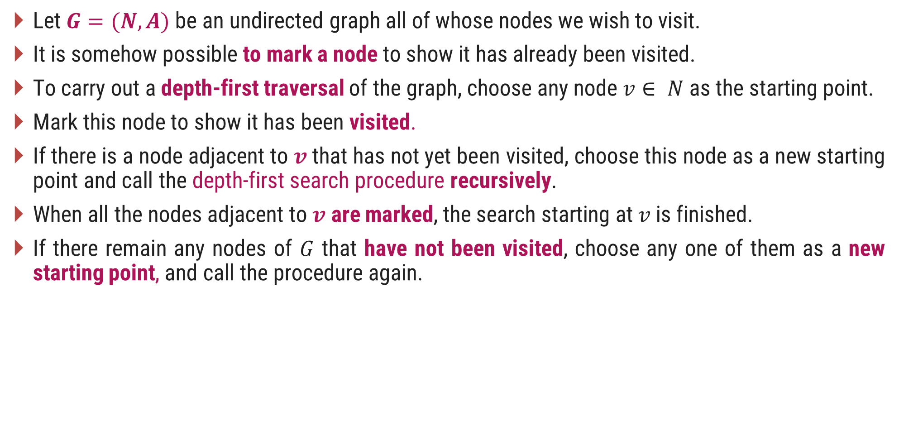
DFS – Procedure
Let $G=(N, A)$be an undirected graph all of whose nodes we wish to visit.
It is somehow possible to mark a node to show it has already been visited.
To carry out a depth-first traversal of the graph, choose any node $v∈ N$as the starting point.
Mark this node to show it has been visited.
If there is a node adjacent to $v$ that has not yet been visited, choose this node as a new starting point and call the depth-first search procedure recursively.
When all the nodes adjacent to $v$ are marked, the search starting at$v$is finished.
If there remain any nodes of $G$ that have not been visited, choose any one of them as a new starting point, and call the procedure again.

Slide 10
Depth-First Search Algorithm
procedure dfsearch(G)
for each v Є N do
mark[v] ← not-visited
for each v Є N do
if mark[v] ≠ visited
then dfs(v)
procedure dfs(v)
{Node v has not previously been visited}
mark[v] ← visited
for each node w adjacent to v do
if mark[w] ≠ visited
then dfs(w)

Slide 11
Depth-First Search - Algorithm
dfs(1) Initial call
dfs(2) recursive call
dfs(3) recursive call
dfs(6) recursive call
dfs(5) recursive call; progress is blocked
dfs(4) a neighbour of node 1 that has not been visited
dfs(7) recursive call
dfs(8) recursive call
There are no more nodes to visit
1
2
3
4
5
6
7
8
procedure dfs(v)
mark[v] ← visited
for each node w adjacent to v do
if mark[w] ≠ visited
then dfs(w)

Slide 12
Breadth First Search / Traversal
1
Select any node v ∈ N as starting point mark that node as visited.
2
3
4
Enqueue visited v node into queue Q
Dequeue a node from the front of queue.
Find it’s all unvisited adjacent nodes, mark as visited, enqueue into queue
5
6
7
8
1
2
3
4
5
6
7
8
Queue Q
Visited :
1
2
3
4
5
6
7
8

Slide 13
Breadth First Search - Algorithm
procedure bfs(v)
Q ← empty-queue
mark[v] ← visited
enqueue v into Q
while Q is not empty do
u ← first(Q)
dequeue u from Q
for each node w adjacent to u do
if mark[w] ≠ visited
then mark[w] ← visited
enqueue w into Q
procedure search(G)
for each v Є N do
mark[v] ← not visited
for each v Є N do
if mark[v] ≠ visited
then bfs(v)

Slide 14
Comparison of DFS and BFS
Depth First Search (DFS) Breath First Search (BFS)
DFS traverses according to tree depth. DFS reaches up to the bottom of a subtree, then backtracks.
BFS traverses according to tree level. BFS finds the shortest path to the destination.
It uses a stack to keep track of the next location to visit.
It uses a queue to keep track of the next location to visit.
DFS requires less memory since only nodes on the current path are stored.
BFS guarantees that the space of possible moves is systematically examined; this search requires considerably more memory resources.
Does not guarantee to find solution. Backtracking is required if wrong path is selected.
If there is a solution, BFS is guaranteed to find it.

Slide 15
Comparison of DFS and BFS
Depth First Search Breath First Search
If the selected path does not reach to the solution node, DFS gets stuck or trapped into an infinite loops.
BFS will not get trapped exploring an infinite loops.
The Time complexity of both BFS and DFS will be O(V + E), where V is the number of vertices, and E is the number of Edges.

Slide 16
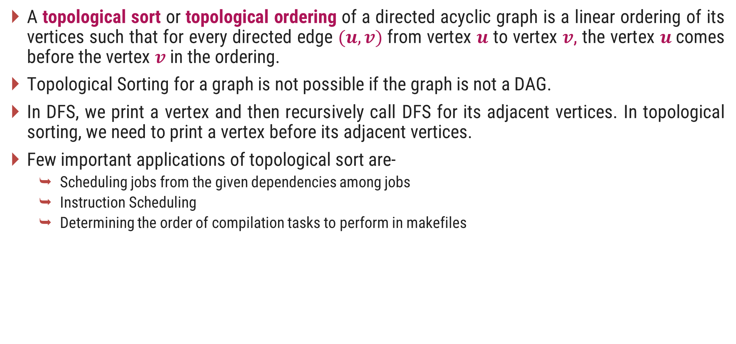
Topological Sorting
A topological sort or topological ordering of a directed acyclic graph is a linear ordering of its vertices such that for every directed edge $(u,v)$from vertex $u$ to vertex $v$, the vertex $u$comes before the vertex $v$ in the ordering.
Topological Sorting for a graph is not possible if the graph is not a DAG.
In DFS, we print a vertex and then recursively call DFS for its adjacent vertices. In topological sorting, we need to print a vertex before its adjacent vertices.
Few important applications of topological sort are-
Scheduling jobs from the given dependencies among jobs
Instruction Scheduling
Determining the order of compilation tasks to perform in makefiles

Slide 17
Topological Sorting – Example 1
B
C
Identify nodes having in degree ‘0’
Select a node and delete it with its edges then add node to output
A
F
D
E
Output:
A
B
C
D
E
F

Slide 18
Topological Sorting – Example 2
5
4
2
0
1
3
Output:
4
5
0
2
3
1

Slide 19
Connected Components
A connected component (or just component) of an undirected graph is a subgraph in which any two vertices are connected to each other by paths.
There are two connected components in the above undirected graph. 0 1 2 and 3 4
1
0
3
4
2

Slide 20
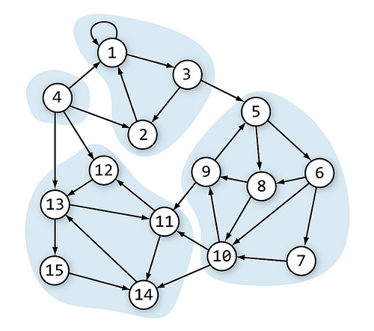
Connected Components
A directed graph is strongly connected if there is a directed path from any vertex to every other vertex.
This is same as connectivity in an undirected graph, the only difference is strong connectivity applies to directed graphs and there should be directed paths instead of just paths.
Similar to connected components, a directed graph can be broken down into Strongly Connected Components.

Slide 21
Articulation Point
An articulation point in a connected graph is a vertex, that if is deleted (and edges through it) then disconnects the graph.
It represent vulnerabilities in a connected network, single points whose failure would split network into two or more disconnected components.
For a disconnected undirected graph, an articulation point is a vertex removing which will increases number of connected components.
1
5
1
2
3
3
7
2
6
4
5
4
Articulation Points: 2,3
Articulation Points: 3

Slide 22
Thank You!

